Slide 1
jQuery - Plugin
Write Less Do More

Slide 2
Agenda
jQuery Plugin
Getting started
Context
Basics
Maintaining chainability
Defaults and options
Namespacing
Plugin Methods
Events
Data
Summary and Best Practices
Plugin Repositories
Data Link Plugin
Templates
Samples

Slide 3
jQuery Plugin
Extending jQuery with plugins and methods is very powerful

Slide 4
Getting Started
To Write a jQuery plugin, create a function
jQuery.fn.myPlugin = function() {
// Do your awesome plugin stuff here
};
OR
(function( $ ){
$.fn.myPlugin = function() {
// Do your awesome plugin stuff here
};
})( jQuery );

Slide 5
Context
(function( $ ){
$.fn.myPlugin = function() {
// there's no need to do $(this) because
// "this" is already a jquery object
// $(this) would be the same as $($('#element')); this.fadeIn('normal', function(){
// the this keyword is a DOM element
});
};
})( jQuery );
Client code will be
$('#element').myPlugin();

Slide 6
Basics
(function( $ ){
$.fn.maxHeight = function() {
var max = 0;
this.each(function() {
max = Math.max( max, $(this).height() );
});
return max;
};
})( jQuery );
Client Code
var tallest = $('div').maxHeight();
// Returns the height of the tallest div
Notes:
Now that we understand the context of jQuery plugins, let's write a plugin that actually does something.
This is a simple plugin that leverages .height() to return the height of the tallest div in the page.

Slide 7
Maintaining Chain ability
(function( $ ){
$.fn.lockDimensions = function( type ) {
return this.each(function() {
var $this = $(this);
if ( !type || type == 'width' ) {
$this.width( $this.width() );
}
if ( !type || type == 'height' ) {
$this.height( $this.height() );
}
});
};
})( jQuery );
Client code
$('div').lockDimensions('width').css('color', 'red');
Notes:
The previous example returns an integer value of the tallest div on the page, but often times the intent of a plugin is simply modify the collection of elements in some way, and pass them along to the next method in the chain. This is the beauty of jQuery's design and is one of the reasons jQuery is so popular. So to maintain chainability in a plugin, you must make sure your plugin returns the this keyword.
Because the plugin returns the this keyword in its immediate scope, it maintains chainability and the jQuery collection can continue to be manipulated by jQuery methods, such as .css. So if your plugin doesn't return an intrinsic value, you should always return the this keyword in the immediate scope of the plugin function. Also, as you might assume, arguments you pass in your plugin invocation get passed to the immediate scope of the plugin function. So in the previous example, the string 'width' becomes the type argument for the plugin function.

Slide 8
Defaults and Options
(function( $ ){
$.fn.tooltip = function( options ) {
var settings = {
'location' : 'top',
'background-color' : 'blue'
};
return this.each(function() {
// If options exist, lets merge them
// with our default settings
if ( options ) {
$.extend( settings, options );
}
// Tooltip plugin code here
});
};
})( jQuery );
Client code
$('div').tooltip({ 'location' : 'left' });
Notes:
For more complex and customizable plugins that provide many options, it's a best practice to have default settings that can get extended (using $.extend) when the plugin is invoked. So instead of calling a plugin with a large number of arguments, you can call it with one argument which is an object literal of the settings you would like to override. Here's how you do it.

Slide 9
Namespacing
Plugin methods
Under no circumstance should a single plugin ever claim more than one namespace in the jQuery.fn object.
(function( $ ){
$.fn.tooltip = function( options ) { // THIS };
$.fn.tooltipShow = function( ) { // IS };
$.fn.tooltipHide = function( ) { // BAD };
$.fn.tooltipUpdate = function( content ) { // !!! };
})( jQuery );
Notes:
Properly namespacing your plugin is a very important part of plugin development. Namespacing correctly assures that your plugin will have a very low chance of being overwritten by other plugins or code living on the same page. Namespacing also makes your life easier as a plugin developer because it helps you keep better track of your methods, events and data.
This is a discouraged because it clutters up the $.fn namespace. To remedy this, you should collect all of your plugin's methods in an object literal and call them by passing the string name of the method to the plugin.

Slide 10
Namespacing
(function( $ ){
var methods = {
init : function( options ) { // THIS },
show : function( ) { // IS },
hide : function( ) { // GOOD },
update : function( content ) { // !!! }
};
$.fn.tooltip = function( method ) { // Method calling logic
if ( methods[method] ) {
return methods[ method ].apply( this, Array.prototype.slice.call( arguments, 1 ));
} else if ( typeof method === 'object' || ! method ) {
return methods.init.apply( this, arguments );
} else {
$.error( 'Method ' + method + ' does not exist on jQuery.tooltip' );
}
};
})( jQuery );
Notes:
This type of plugin architecture allows you to encapsulate all of your methods in the plugin's parent closure, and call them by first passing the string name of the method, and then passing any additional parameters you might need for that method. This type of method encapsulation and architecture is a standard in the jQuery plugin community and it used by countless plugins, including the plugins and widgets in jQueryUI

Slide 11
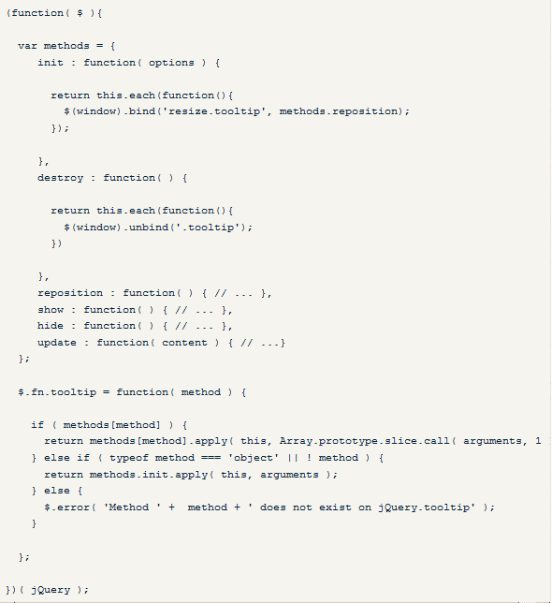
Namespacing
Notes:
A lesser known feature of the bind method is that is allows for namespacing of bound events. If your plugin binds an event, its a good practice to namespace it. This way, if you need to unbind it later, you can do so without interfering with other events that might have been bound to the same type of event. You can namespace your events by appending “.<namespace>” to the type of event you're binding.
In this example, when the tooltip is initialized with the init method, it binds the reposition method to the resize event of the window under the namespace 'tooltip'. Later, if the developer needs to destroy the tooltip, we can unbind the events bound by the plugin by passing its namespace, in this case 'tooltip', to the unbind method. This allows us to safely unbind plugin events without accidentally unbinding events that may have been bound outside of the plugin.

Slide 12
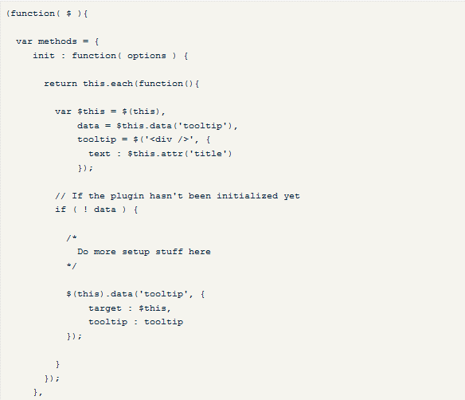
Namespacing
Data
Notes:
Often times in plugin development, you may need to maintain state or check if your plugin has already been initialized on a given element. Using jQuery's data method is a great way to keep track of variables on a per element basis. However, rather than keeping track of a bunch of separate data calls with different names, it's best to use a single object literal to house all of your variables, and access that object by a single data namespace.

Slide 13
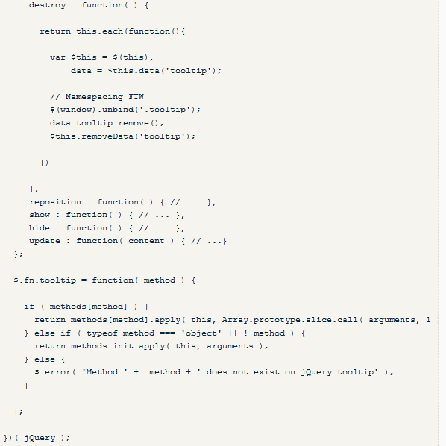
Namespacing
Notes:
Using data helps you keep track of variables and state across method calls from your plugin. Namespacing your data into one object literal makes it easy to access all of your plugin's properties from one central location, as well as reducing the data namespace which allows for easy removal if need be.

Slide 14
Summary and Best Practices
Always wrap your plugin in (function( $ ){ // plugin goes here })( jQuery );
Don't redundantly wrap the this keyword in the immediate scope of your plugin's function
Unless you're returning an intrinsic value from your plugin, always have your plugin's function return the this keyword to maintain chainability.
Notes:
Writing jQuery plugins allows you to make the most out of the library and abstract your most clever and useful functions out into reusable code that can save you time and make your development even more efficient. Here's a brief summary of the post and what to keep in mind when developing your next jQuery plugin:

Slide 15
Summary and Best Practices
Rather than requiring a lengthy amount of arguments, pass your plugin settings in an object literal that can be extended over the plugin's defaults.
Don't clutter the jQuery.fn object with more than one namespace per plugin.
Always namespace your methods, events and data.
jQuery.fn is pronounced jQuery effin'

Slide 16
Plugin Repositories
The jQuery plugins will be available in the following repository link.
http://plugins.jquery.com/

Slide 17
Data Link Plugin
Data Linking here refers to linking a field of one object to another field of another object.
.link()
Syntax
.link( target, [ settings ] )
Ex
var person = {}; $("form").link(person, { firstName: "first-name", lastName: "last-name" });
Notes:
If the objects are linked, then changing the value of the field on the first object automatically updates the value of the linked field on the other object.

Slide 18
Data Link Plugin
.unlink()
Syntax
.unlink( target )
Ex
var person = {}; $("input").link(person); $(".nolink").unlink(person);

Slide 19
Templates Plugin
.tmpl()
Syntax
.tmpl( [ data ], [ options ] )
Ex
$( "#myTemplate" ).tmpl( myData ).appendTo( "#target" );
jQuery.tmpl()
Syntax
jQuery.tmpl( template, [ data ], [ options ] )
Ex
$.tmpl( "<li>${Name}</li>", { "Name" : "John Doe" }).appendTo( "#target" );

Slide 20
Template Plugin
.tmplItem()
Syntax
.tmplItem()
Ex
var tmplItem = $( selector ).tmplItem();
jQuery.tmplItem()
Syntax
jQuery.tmplItem( element )
Ex
var tmplItem = $.tmplItem( this );

Slide 21
Template Plugin
.template()
Syntax
.template( [ name ] )
Ex
$( "#titleTemplate" ).template( "summaryTemplate" );
jQuery.template()
Syntax
jQuery.template( name, template )
jQuery.template( template )
Ex
$.template( "summaryTemplate", "<li>${Name}</li>" );

Slide 22
Template Plugin
${} Template Tag
Syntax
${fieldNameOrExpression}
Ex
${Name}</b> was released in ${ReleaseYear}.
{{html}} Template Tag
Syntax
{{html fieldNameOrExpression}}
Ex
<h4>${Name}</h4> <p>{{html Synopsis}}</p>

Slide 23
Template Plugin
{{if}} Template Tag
Syntax
{{if fieldNameOrExpression}} content {{/if}}
Ex
<li> Title: ${Name}. {{if Languages}} (Alternative languages: ${Languages}). {{/if}} </li>
{{else}} Template Tag
Syntax
{{else fieldNameOrExpression}} content {{/if}}
Ex
Title: ${Name}. {{if Languages}} (Alternative languages: ${Languages}). {{else}} (Available only in the original version). {{/if}}

Slide 24
Template Plugin
{{each}} Template Tag
Syntax
{{each}} Template Tag
Ex
Title: ${Name}. {{each Languages}} ${$index + 1}: <em>${$value}. </em> {{/each}}
{{tmpl}} Template Tag
Syntax
{{tmpl( [data], [options] ) template}} content {{/tmpl}}
Ex
<script id="movieTemplate" type="text/x-jquery-tmpl"> {{tmpl "#titleTemplate"}} <tr class="detail"><td>Director: ${Director}</td></tr> </script>
<script id="titleTemplate" type="text/x-jquery-tmpl"> <tr class="title"><td>${Name}</td></tr> </script>

Slide 25
Template Plugin
{{wrap}} Template Tag
Syntax
{{wrap( [data], [options] ) template}} content {{/wrap}}
Ex
<script id="myTmpl" type="text/x-jquery-tmpl"> The following wraps some HTML content: {{wrap "#tableWrapper"}} <div> First <b>content</b> </div> <div> And <em>more</em> <b>content</b>... </div> {{/wrap}} </script>
<script id="tableWrapper" type="text/x-jquery-tmpl"> <table><tbody> <tr> {{each $item.html("div")}} <td> {{html $value}} </td> {{/each}} </tr> </tbody></table> </script>

Slide 26
Q & A

